Slide 1
React JS

Slide 2
What is React ?
React is a popular JavaScript library for building user interfaces, particularly single-page applications.
It was developed and is maintained by Facebook, and it is used by many developers and organizations for its efficiency and flexibility
It is not a Framework It is full of Javascript Library and it will Focus only on User Interfaces parts.

Slide 3
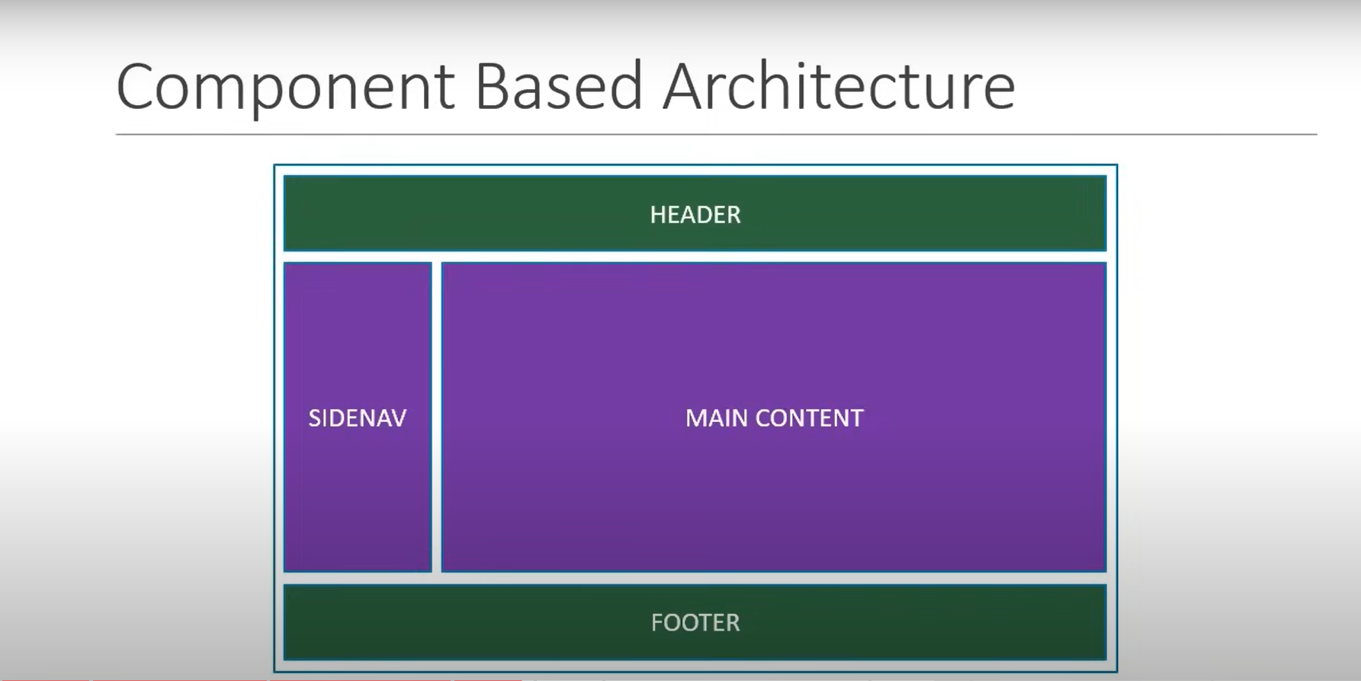
Component Based Architecture
React applications are built using components, which are self-contained and reusable pieces of code that define the UI. Components can be nested, managed, and handled independently. We can use reusable code

Slide 4
JSX: JavaScript XML
JSX, or JavaScript XML, is a syntax extension for JavaScript used in React to describe what the UI should look like. It allows you to write HTML-like code directly within JavaScript, making it easier to create and visualize React components. Here's a detailed look at JSX and how it works in React
Example:
import React from 'react';
function HelloWorld() {
return <h1>Hello, World!</h1>;
}
export default HelloWorld;

Slide 5
Project Setup:
Install Node.js and npm:
Make sure you have Node.js and npm (Node Package Manager) installed. You can download and install them from nodejs.org.
Create React App:
Following Command : npx create-react-app my-react-app
Prerequisites:
JavaScript Fundamentals:
HTML and CSS
ES6+ Syntax: Familiarize yourself with modern JavaScript features such as arrow functions, classes, destructuring, template literals, async/await, and modules.

Slide 6
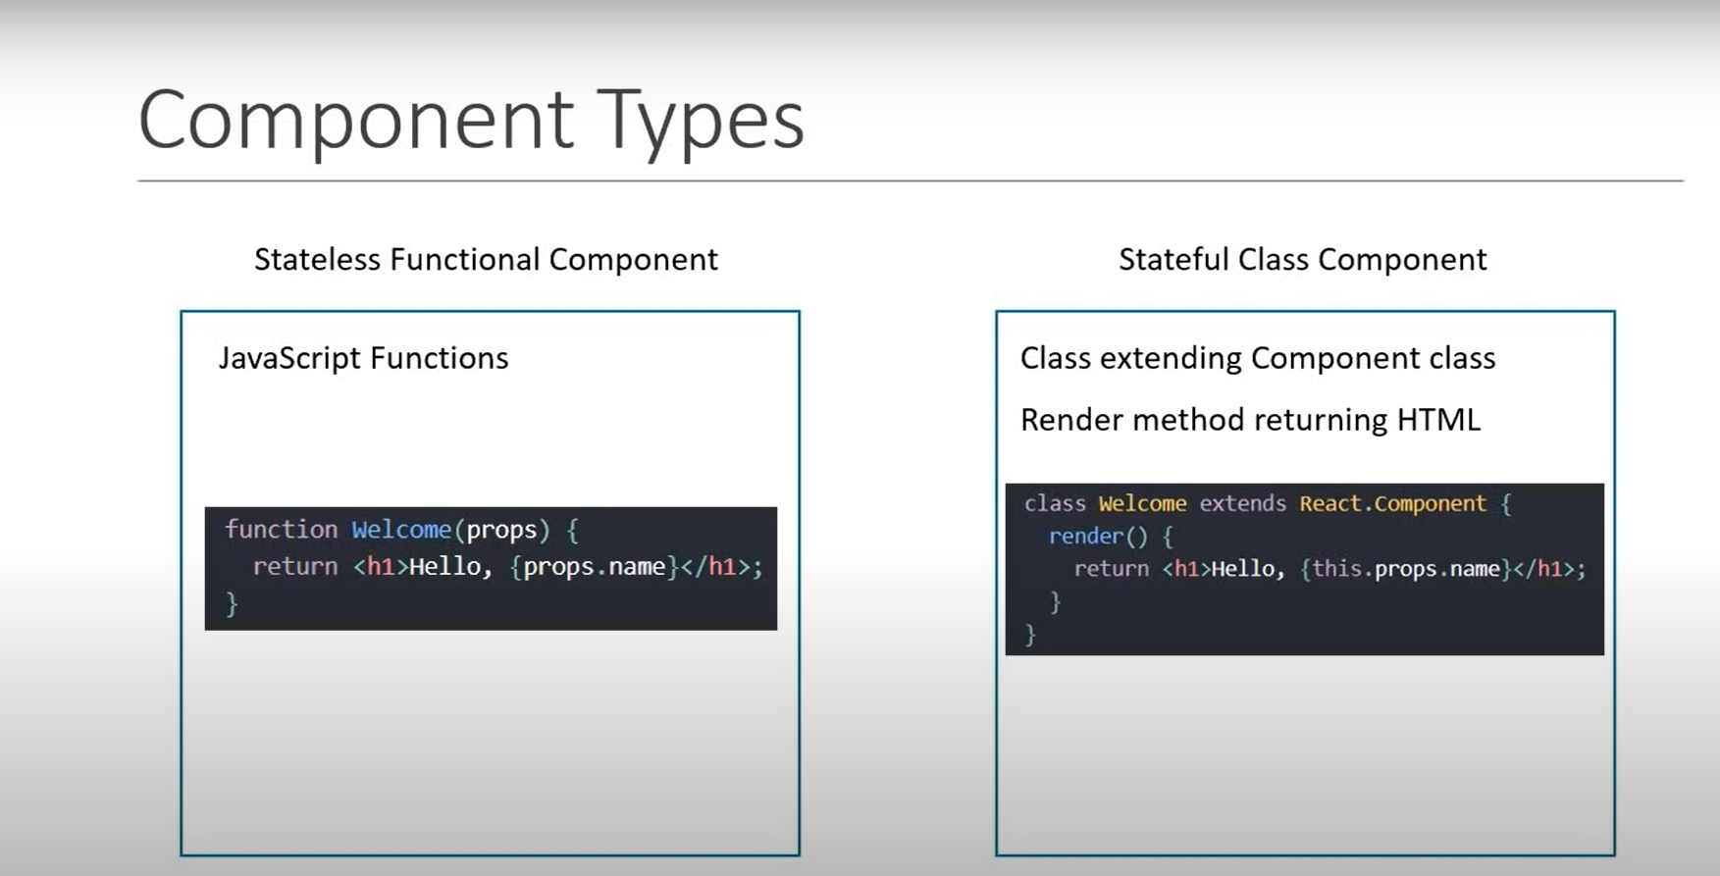
Components:
Stateless Functional Component
StateFull Class Component

Slide 7
Functional Component
A functional component in React is a JavaScript function that returns a React element (usually created using JSX). Unlike class components, functional components do not have their own state or lifecycle methods by default.
example:
import React from 'react';
function MyComponent() {
return ( <div> <h1>Hello, World!</h1> </div> );
}
export default MyComponent;

Slide 8
Class Component
A class component in React is a JavaScript class that extends “React.Component”.It includes a render() method that returns a JSX elements to rendered to the DOM.
Example:
import React, { Component } from 'react';
class MyComponent extends Component {
render() {
return ( <div> <h1>Hello, World!</h1> </div> );
} }
export default MyComponent;

Slide 9
State Vs Props:
Props
Props (short for "properties") are read-only attributes passed from a parent component to a child component. They allow data to flow down the component tree, enabling child components to render dynamically based on the data received from their parents.
Immutability:
Props are immutable, meaning that once set, they cannot be changed by the child component. This ensures a unidirectional data flow, which helps maintain predictable and manageable state in the application.
Using Props:
Passing Props: Props are passed to a child component in a similar manner to HTML attributes.
Accessing Props: In functional components, props are accessed directly via the function arguments. In class components, they are accessed via “this.props”

